Slide 1




Mobile Application Development
Produced
by
Dave Drohan (david.drohan@setu.ie)
Department of Computing & Mathematics
South East Technological University Waterford, Ireland
Updated & Delivered
by
Gongzhe Qiao (003969@nuist.edu.cn)
Department of Computer Science
Nanjing University of Information Science and Technology Nanjing, China
nuist.edu.cn
setu.ie

Slide 2
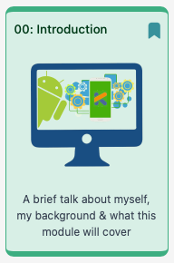
Background & Overview

Slide 3
Outline
My Background
Course Purpose
Case Study
Course Structure
Assessment

Slide 4
My Background
Gongzhe Qiao(乔塨哲)
BEng. of Information Security Engineering‌, Shanghai Jiao Tong University, China
MSc. and PhD. of Cyberspace Security, Nanjing University of Aeronautics and Astronautics, China
R&D on Mobile Network / IoT / Risk Assessment
Contact details
003969@nuist.edu.cn (email)
Bld. Linjiang 临江楼 A1405 (office)

Slide 5
Course Purpose
Introduce Kotlin & Android application development through a Case Study and targeted practical labs on a week by week basis

Slide 6
Course Purpose
Introduce Kotlin & Android application development through a Case Study and targeted practical labs on a week by week basis
Assumptions:
Intermediate level Java or closely related language skills
Accelerate into Kotlin fundamentals as we need them
Every topic explores specific Kotlin features in parallel to android code

Slide 7
Case Study
Placemark – a Kotlin Android App to keep track of your favourite places (or placemarks) to visit.
App (Complete) Features
Add a Placemark with a ‘title’ and ‘description’ (and photo!)
Display a list of all Placemarks to the user AND on a Map
Select a particular Placemark and display those details to the user
Edit a particular Placemark
Store all Placemark data in a JSON file

Slide 8
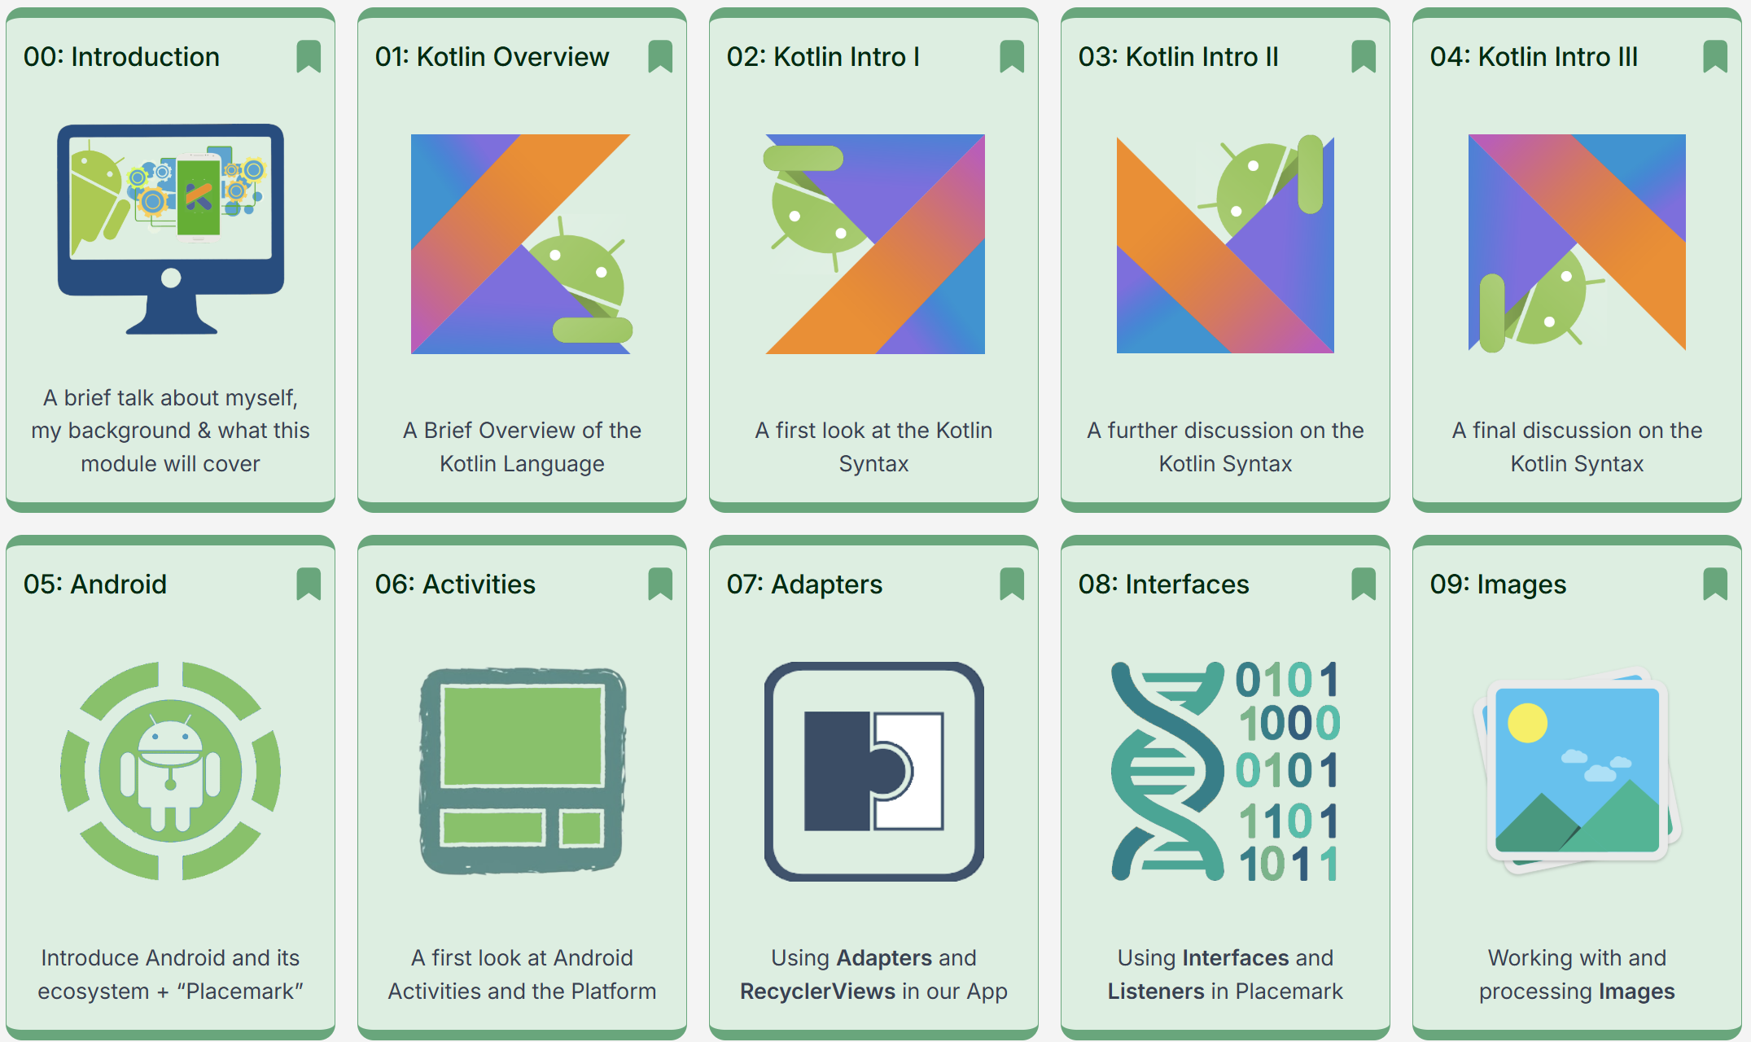
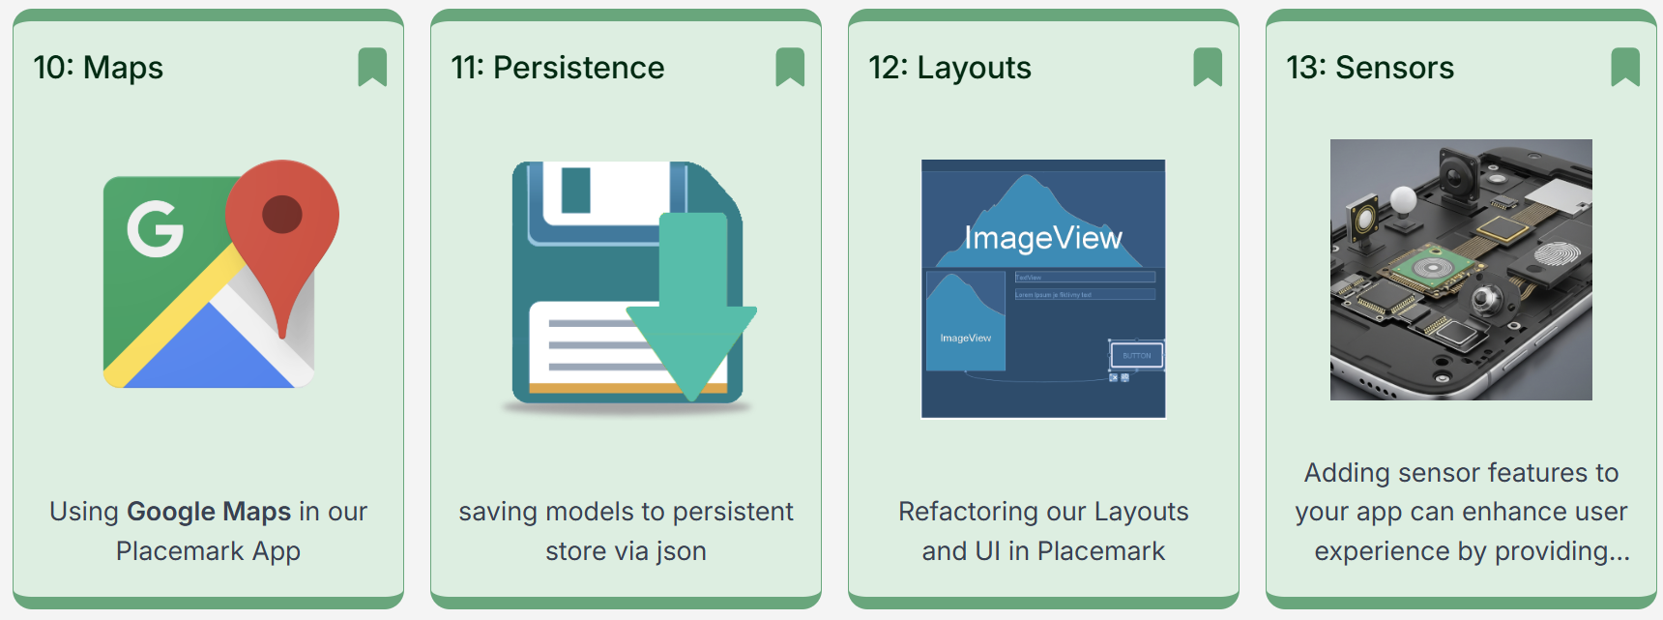
Course Structure

Slide 9
Course Structure – PART 00
Module Overview
The Kotlin Language (~3 weeks)

Slide 10
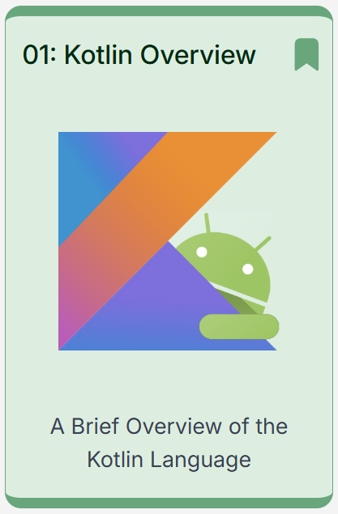
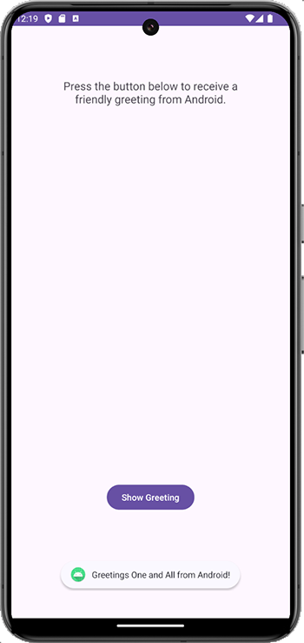

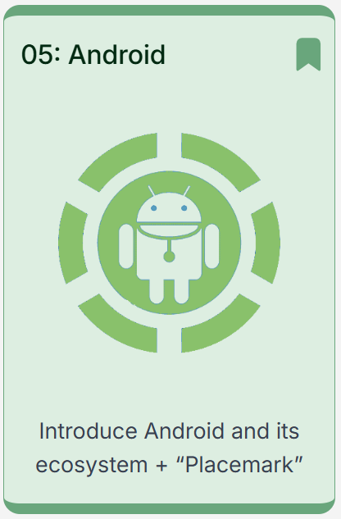
Course Structure – PART 01
Module Overview
Android Studio Setup
“Greetings” +
Skeleton
“Placemark”
App

Slide 11
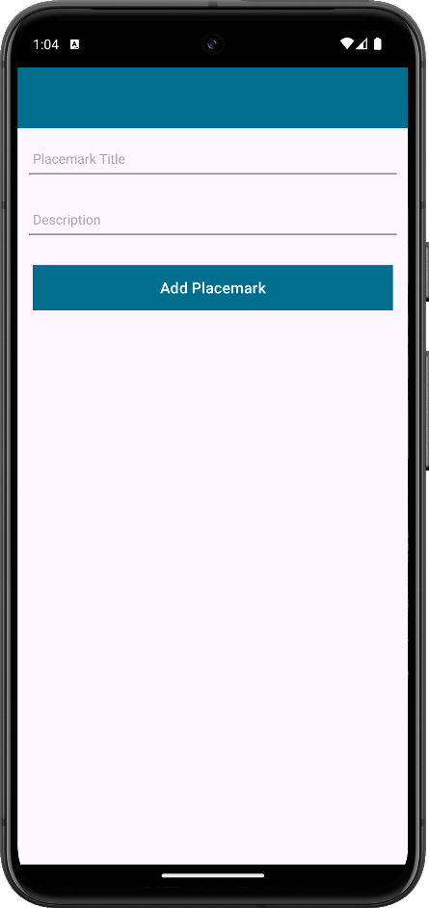
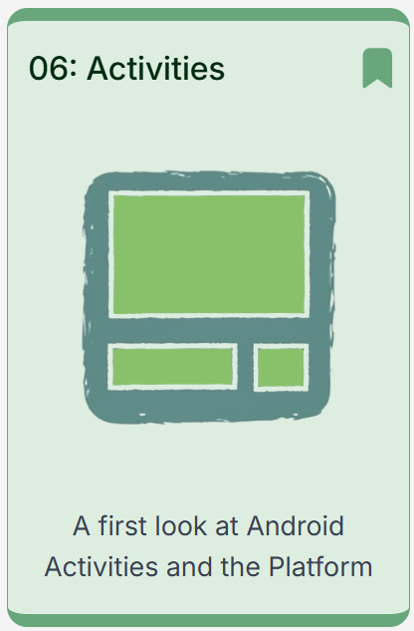
Course Structure – PART 06
Placemark
Single Activity Android Application
Accepts: - Placemark Title
- Placemark Description

Slide 12
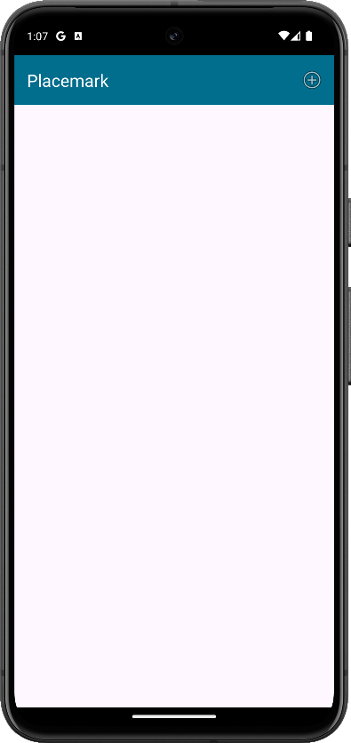
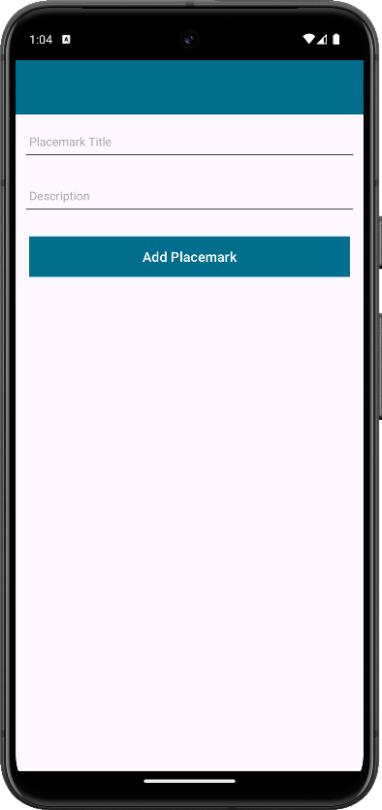
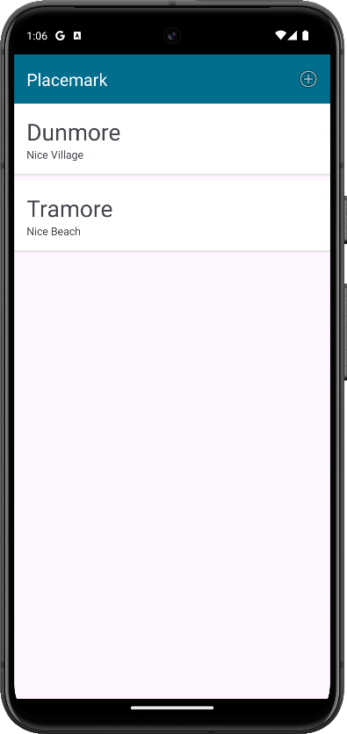
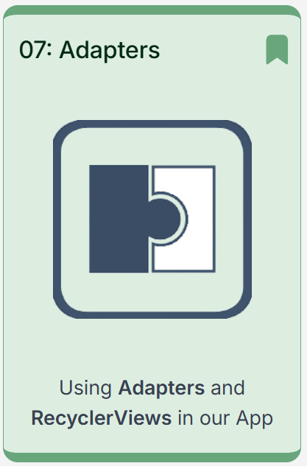
Course Structure – PART 07
Add Placemark
List All Added Placemarks

Slide 13

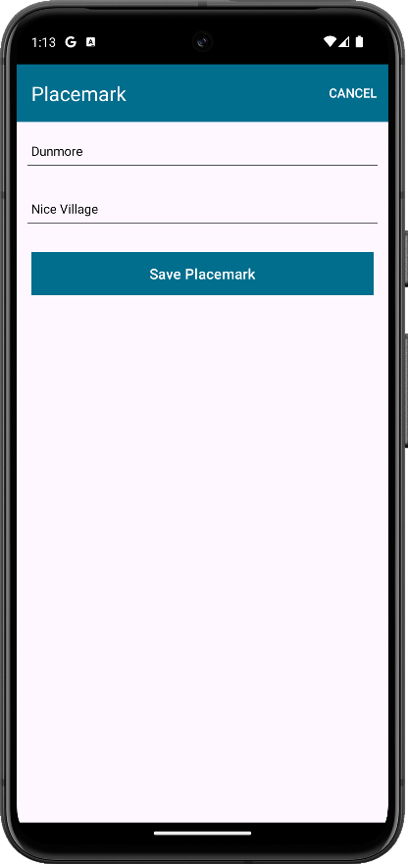
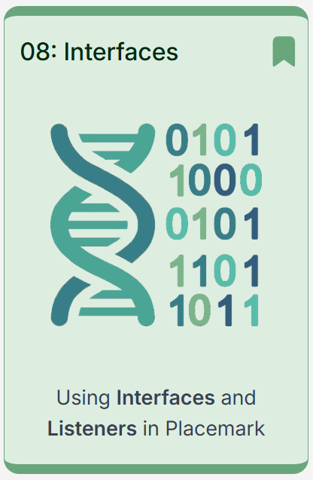
Course Structure – PART 08
Modify Design
Edit Existing Placemarks

Slide 14
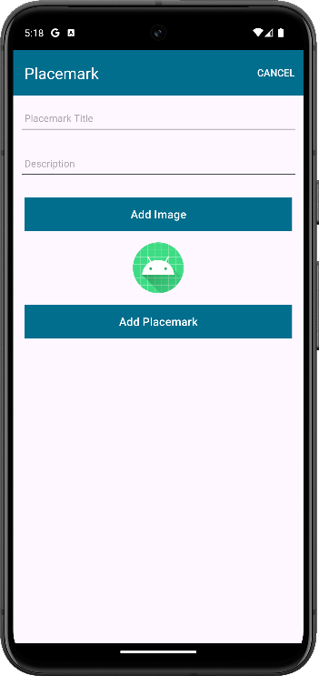
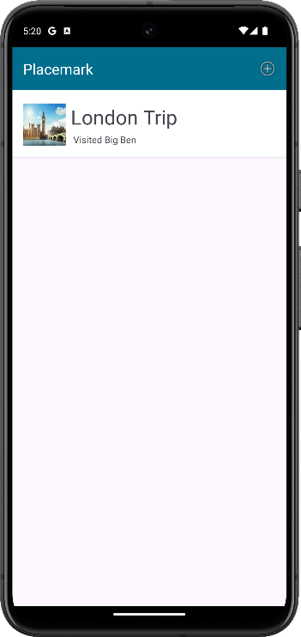
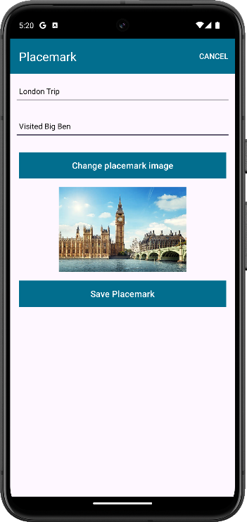
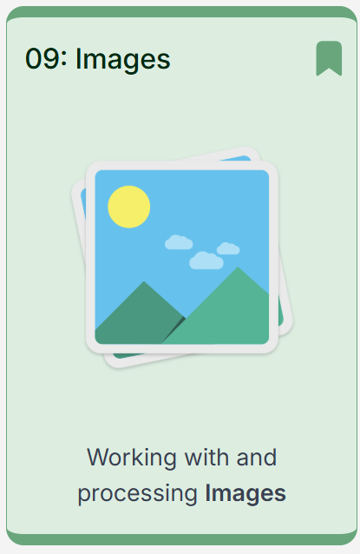
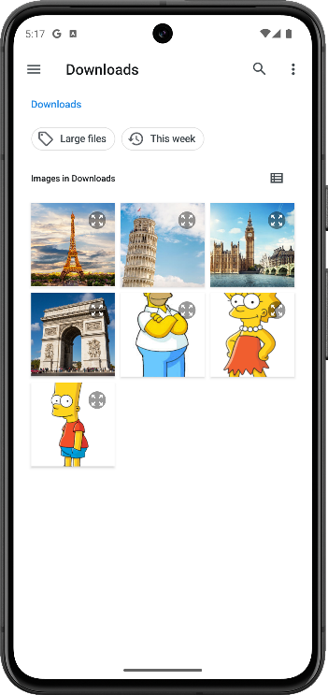
Course Structure – PART 09
Include
Images in Placemarks

Slide 15
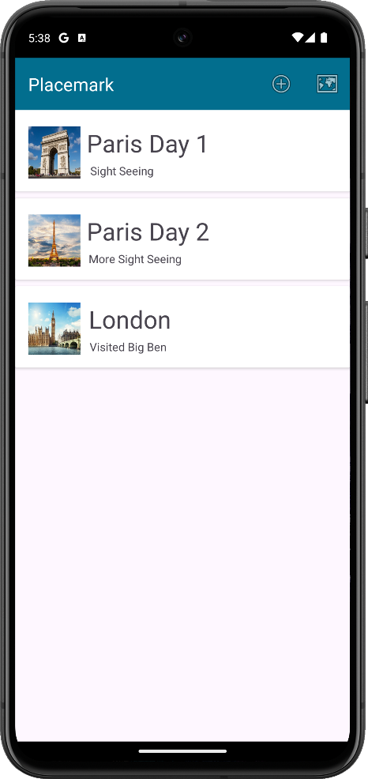
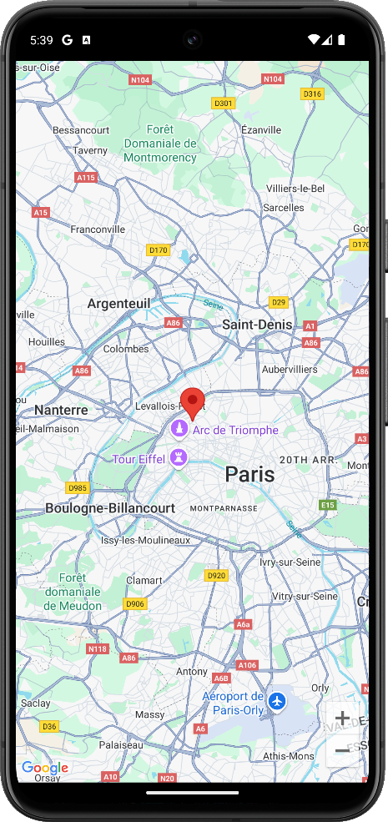
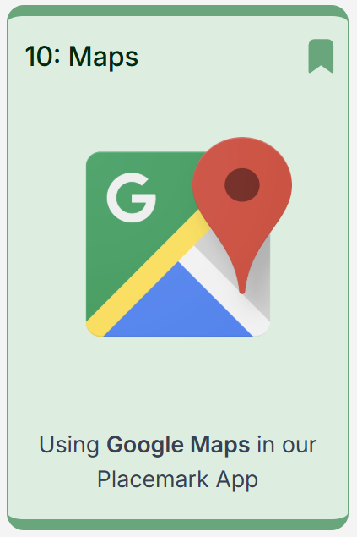
Course Structure – PART 10
Choose
a Location
for the Placemark

Slide 16
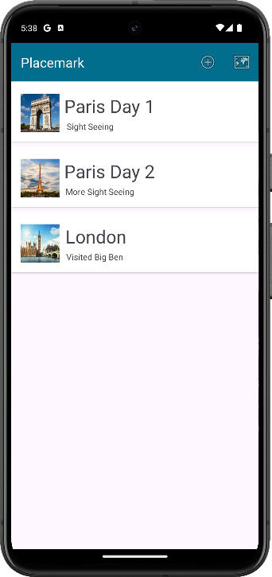
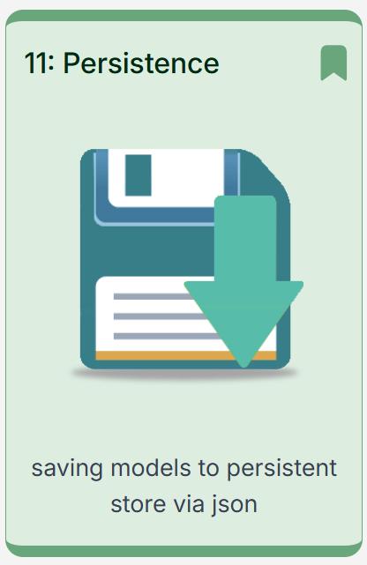
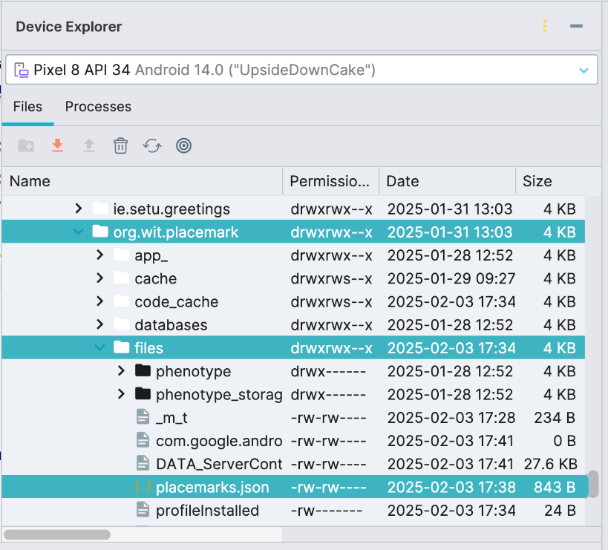
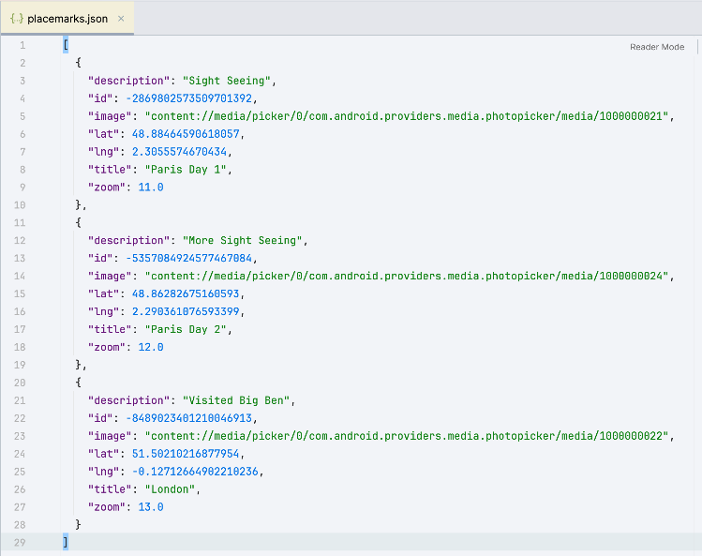
Course Structure – PART 11
Save Placemarks to Disk

Slide 17

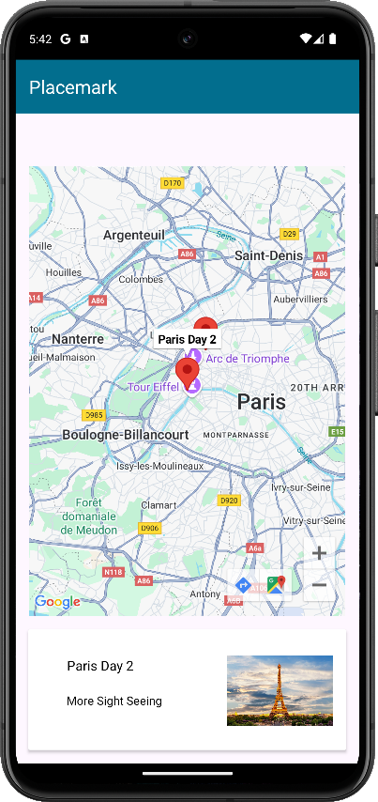
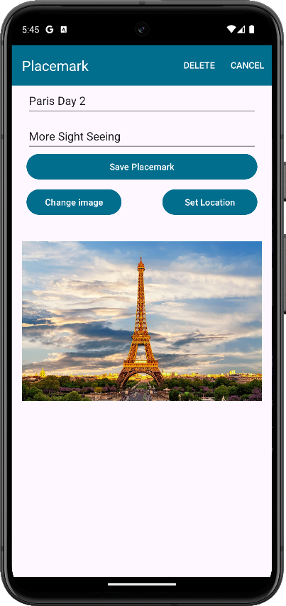
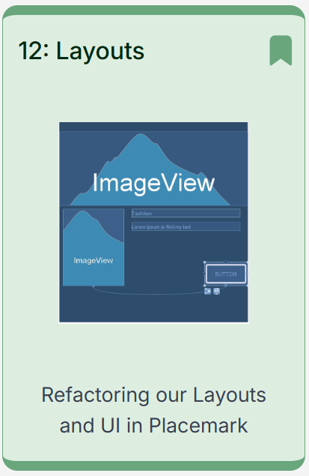
Course Structure – PART 12
Modify
Add/Edit
Display All Placemarks on a Map

Slide 18
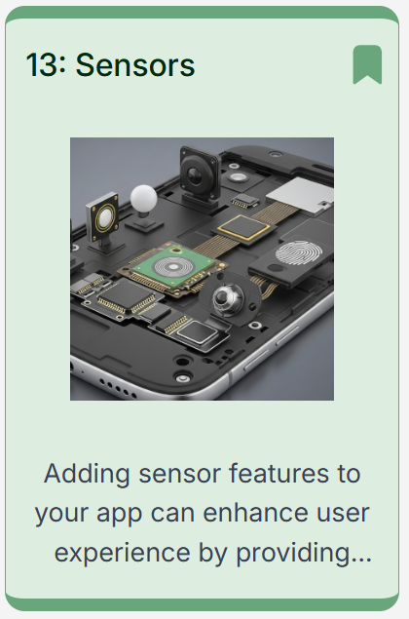
Course Structure – PART 13
Modify
Add/Edit
Display All Placemarks on a Map

Slide 19
Assessment *
100% Continuous Assessment Module (TBC)
20% - Attendance, assignments & lab reports
We will have 12 lab activities.
30% - Course Project Idea Formation (mid-term)
Mid-term report about your course project plan
50% - Course Project Assessment (end-term)
You will form a team
develop a real app
and showcase it!

Slide 20
Assessment *
100% Continuous Assessment Module (TBC)
20% - Attendance, assignments & lab reports
We will have 12 lab activities.
Ideally, we should have tuition -> practice for each PART.
2 assignments (lightweight).
Individual assessment.
To be confirmed, pay attention to our notice!

Slide 21
Assessment *
About your course project (mid-term + end-term)
Form your development team: 1~3 members. Ideally, you will need at least:
1 UI developer (front-end) + 1 backend developer
Assessment is team-based, all credits go to the team
A one-person team is fine but NOT recommended!
Team formation deadline: Week 4

Slide 22
Assessment *
About your course project (mid-term + end-term)
Before mid-term: you will need a project idea
A short presentation (mid-term, TBC)
A poster about your app (1-page, A3 sized, landscape).
Project Ideas MUST be unique AND all your own original work (mostly!)
1st come 1st served approach to Project Titles
Accepting Project Proposal from Week 4 until mid-term
More details will come later on

Slide 23
Assessment *
About your course project (mid-term + end-term)
End-term: due 8th June 23:59 (end of Week 16)
10% +2% per day deduction for every day late
Demos & Presentation Week 17, as end-term exam (TBC)
Attendance is required, absence will have NO SCORE!

Slide 24
Assessment *
In summary, you need to:
Make two presentations (1 mid-term + 1 end-term)
One poster
Two slide
Submit your source code (end-term)
A github repository (with commit logs!)
A .zip file
Make demo video showcasing how it works (end-term)
Up to 5 minutes
A .mp4 file

Slide 25
Assessment *
FAQ
Q: Can I develop a game?
A: Yes. But if you use non-Android IDEs (e.g., Unity3D, UE5, etc.), you have to add Android features (i.e., only Android can do, such as sensors, camera, voice control, etc.)

Slide 26
Assessment *
FAQ
Q: What are the marking criteria for my app?
A: You app will be evaluated as follows:
App Idea (mid-term): novelty, usefulness, poster design
UI Design: following a design guidance, having multiple themes, etc.
Implementation: coding style, project management (git log), completeness, functions
Advancement: using the-state-of-the-art techniques/features
Connectivity: exchanging data with server/other devices
Showcase (end-term): how you showcase your app

Slide 27
Assessment *
Bonus / awards (TBC)
Q: What are the marking criteria for my app?
A: You app will be evaluated as follows:
We will set multiple awards for your apps (TBC), such as
Greatest Of The Year (GOTY)
Best Poster Award (mid-term)
Most Useless But FUN App
Best UI Design Award

Slide 28
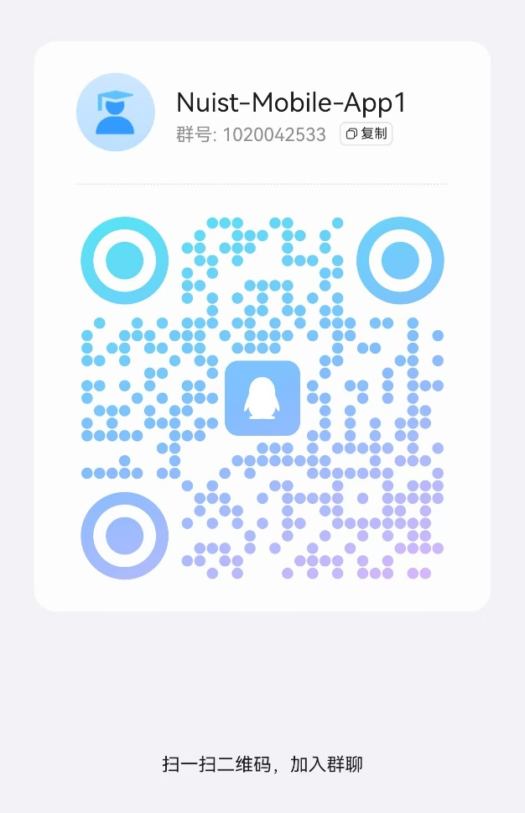

Resources
Chaoxing (学习通)
You should be already in

Slide 29
Resources
Or…take your code and come to my office
Contact details
weiweijiangcn@gmail.com (email)
Bld. Linjiang 临江楼 A1406 (office)
www.weiweijiang.xyz (website)
However …

Slide 30
Some Questions & Tips
This is a coding course …
take your laptop if you can

Slide 31
Some Questions & Tips
I don’t want to be an SDE,
why do I need to learn this?
-> Survey

Slide 32
Some Questions & Tips
AI can write codes well,
why do I need to learn this?
-> Survey

Slide 33
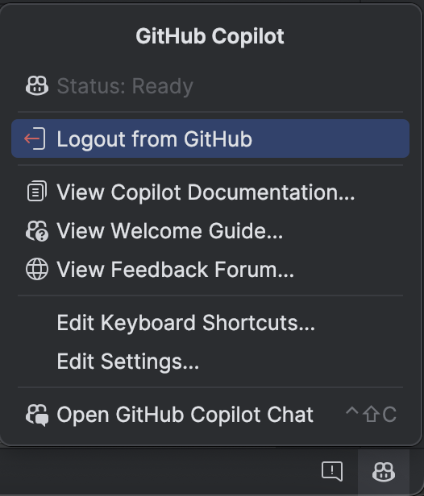
Some Questions & Tips
We will cover some AI tools in this course

Slide 34
Some Questions & Tips
Errors, errors, errors …

Slide 35
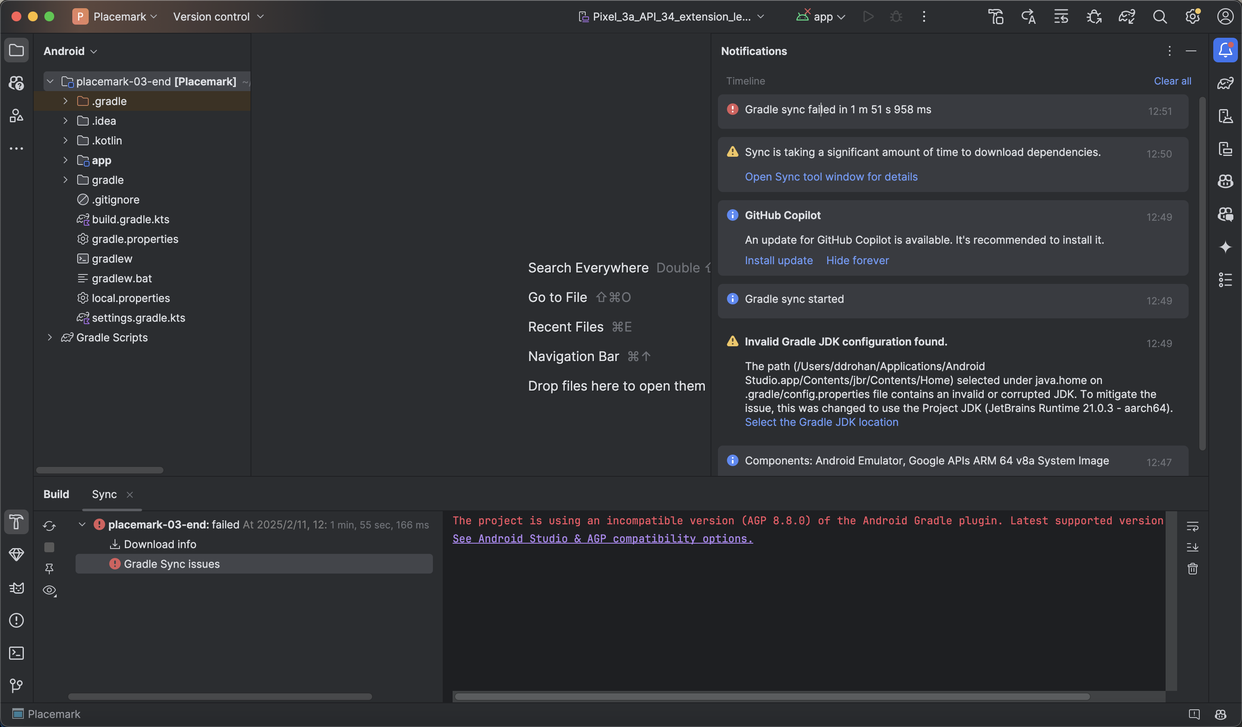
Some Questions & Tips
Just read and solve it!

Slide 36
Some Questions & Tips
Before asking for help, you should:
Search online about your errors, 99.9999…% of your errors are common
Or ask AI (how? We will discuss later)
When you ask for help, you are expected to:
Describe your errors
What you have tried but failed (important!)

Slide 37
Some Questions & Tips
Engineering is about
solving problems!

Slide 38


